Slide 1
A BIOINFORMATICS APPROACH FOR IDENTICAL SALIVARY BIOMARKER DISCOVERY

Slide 2
AIM:
To utilize bioinformatics tools and computational analysis to identify potential salivary biomarkers for disease diagnosis and monitoring, enabling non-invasive and efficient biomarker discovery.
OBJECTIVE:
Quality control, adapter trimming, and genome mapping.
Assessment of biomarker roles in disease relevance.

Slide 3

INTRODUCTION TO BIOMARKERS IN SALIVA ?
What are Biomarkers:
Biomarkers are biological molecules found in body fluids and tissues.
They indicate normal physiological processes, disease states, or responses to treatment.
Examples include proteins, nucleic acids (DNA, RNA), and metabolites.
Why Use Saliva for Biomarkers?
Non-invasive & Easy Collection
Rich in Diagnostic Molecules
Cost-effective & Convenient
Real-time Monitoring

Slide 4

DATA COLLECTIONS
This is the data which is collected form NCBI
PATIENTS | CANCER PATIENT‘S | CONTROL PATIENT’S | CHRONIC PATIENT‘S
1 | SRR32675112 | SRR32675086 | SRR32675109
2 | SRR32675111 | SRR32675085 | SRR32675108
3 | SRR32675100 | SRR32675084 | SRR32675107
4 | SRR32675089 | SRR32675083 | SRR32675106
5 | SRR32675078 | SRR32675082 | SRR32675105
6 | SRR32675067 | SRR32675081 | SRR32675104
7 | SRR32675063 | SRR32675080 | SRR32675103
8 | SRR32675062 | SRR32675079 | SRR32675102
9 | SRR32675061 | SRR32675077 | SRR32675101
10 | SRR32675060 | SRR32675076 | SRR32675099
LINK: https://www.ncbi.nlm.nih.gov/Traces/study/?acc=SRP493350&o=acc_s%3Aa

Slide 5
WORKFLOW FOR FINDING BIOMARKERS USING GALAXY
Raw Data Input
Quality Control
Adapter Trimming
Mapping with Reference Genome
Feature Count
Differential Expression Analysis
Functional Analysis

Slide 6
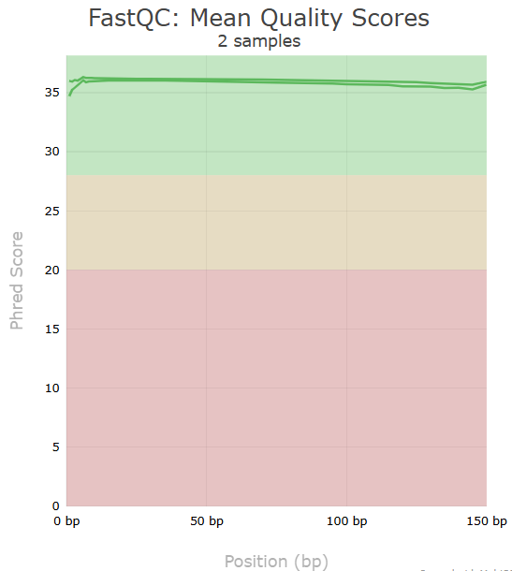
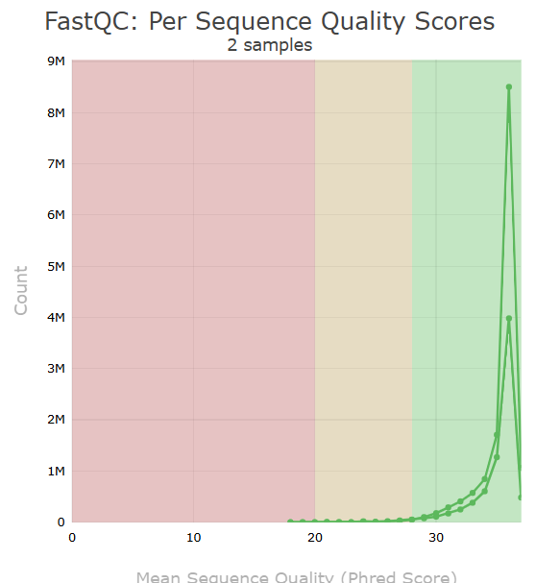
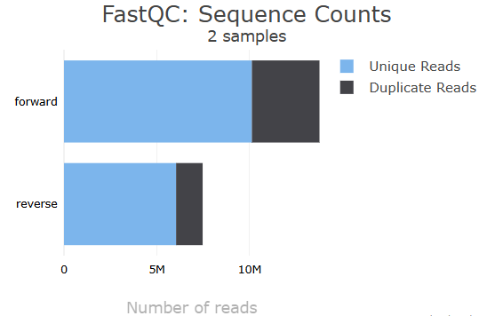
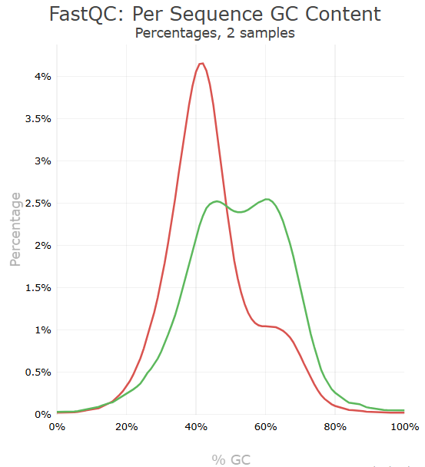
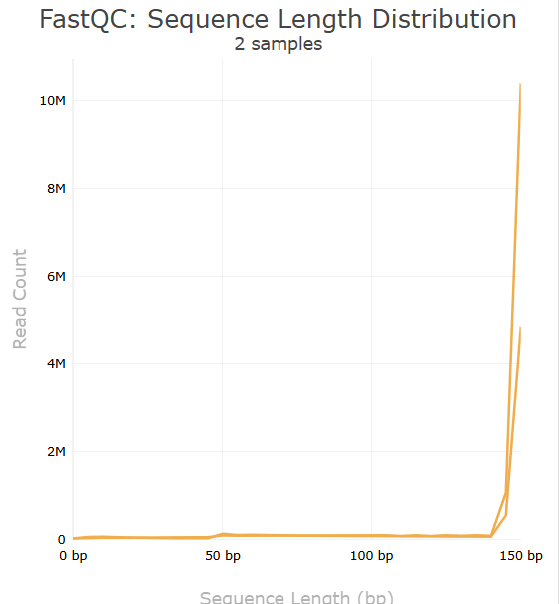
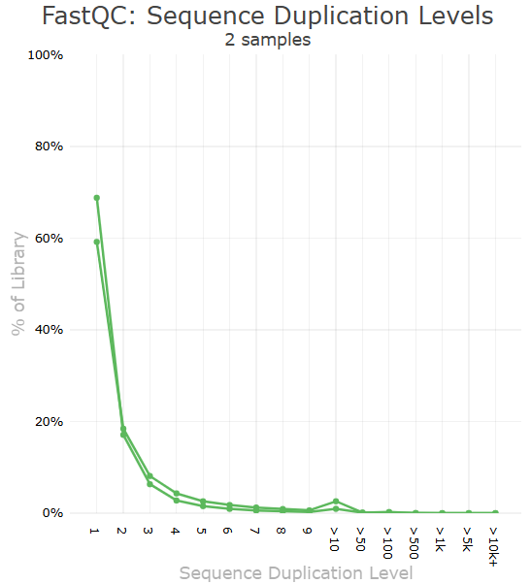
CANCER PATIENT AFTER TRIMMOMATIC
RESULTS
Sample Name | Dups | GC | Seqs
forward | 26.5% | 43.0% | 13.8M
reverse | 19.2% | 52.0% | 7.5M

Slide 7
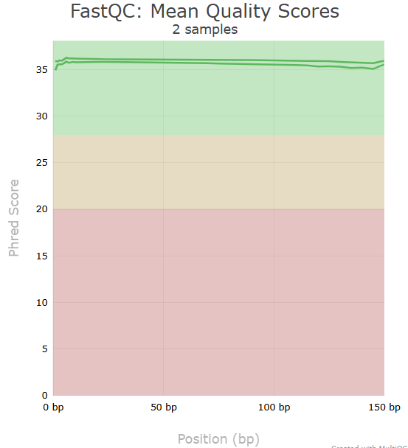
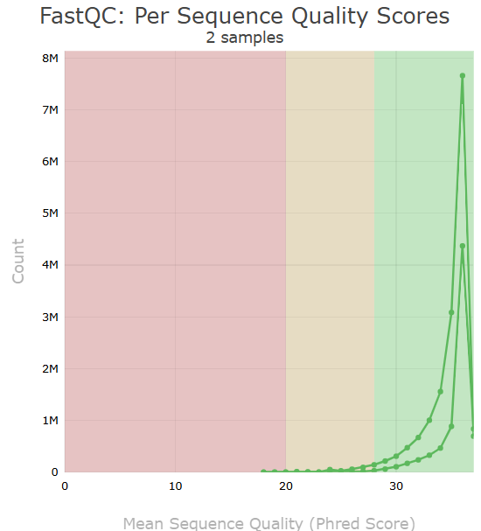
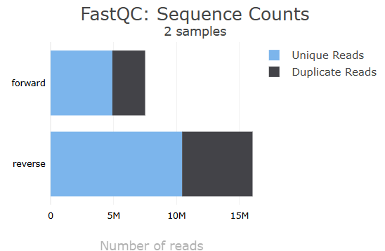
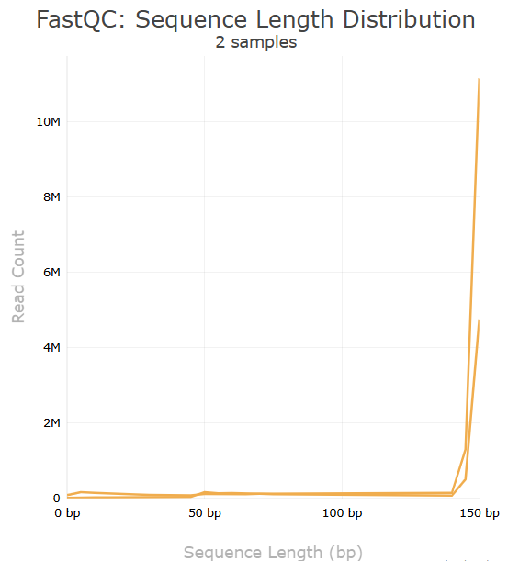
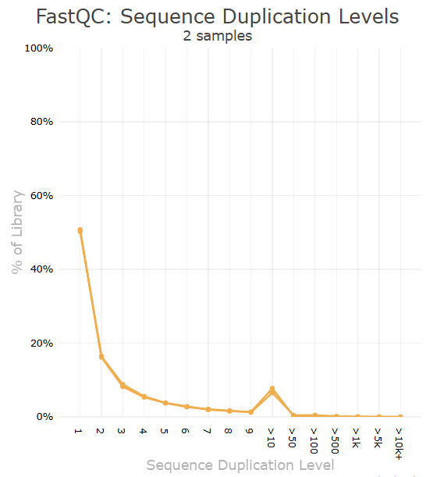
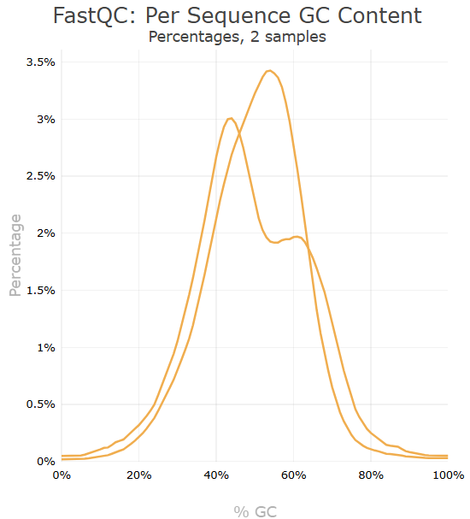
CONTROL PATIENT AFTER TRIMMOMATIC
Sample Name | Dups | GC | Seqs
forward | 34.7% | 49.0% | 7.5M
reverse | 34.9% | 49.0% | 16.0M

Slide 8

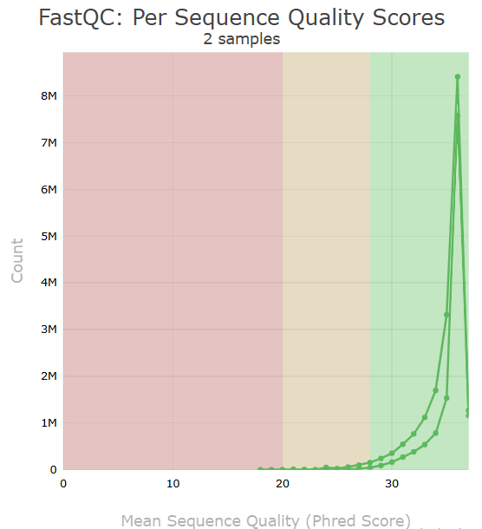
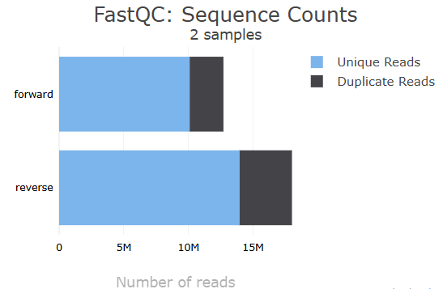
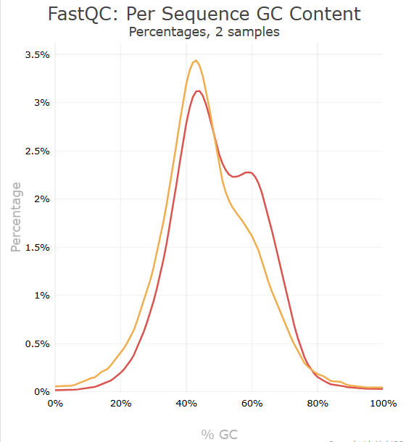
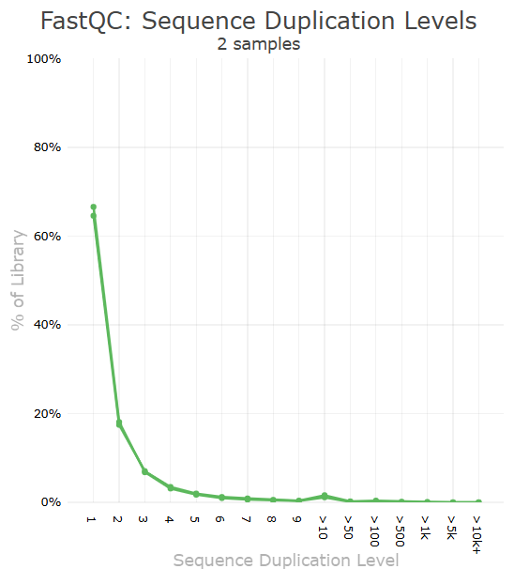
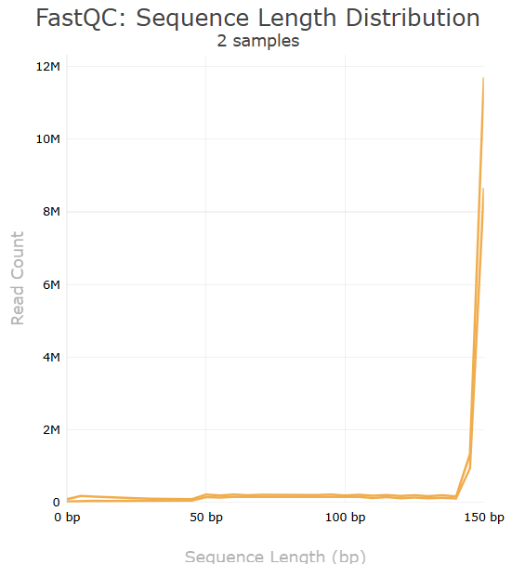
CHRONIC PATIENT AFTER TRIMMOMATIC
Sample Name | Dups | GC | Seqs
forward | 20.6% | 48.0% | 12.7M
reverse | 22.5% | 45.0% | 18.0M

Slide 9
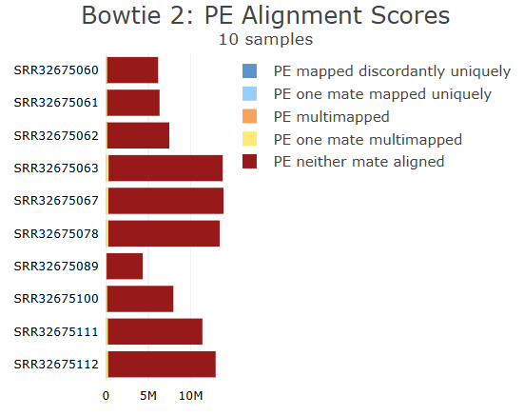
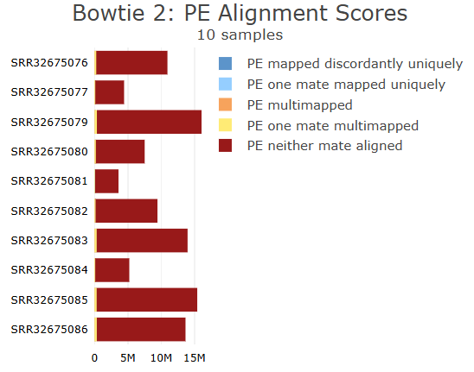
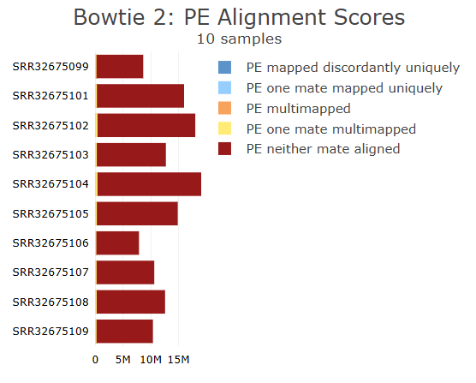
CANCER PATIENT AFTER MAPPING
CONTROL PATIENT AFTER MAPPING
CHRONIC PATIENT AFTER MAPPING
Sample Name | % Aligned
SRR32675060 | 2.3%
SRR32675061 | 2.3%
SRR32675062 | 2.0%
SRR32675063 | 2.3%
SRR32675067 | 2.0%
SRR32675078 | 2.1%
SRR32675089 | 1.9%
SRR32675100 | 1.9%
SRR32675111 | 2.0%
SRR32675112 | 2.0%
Sample Name | % Aligned
SRR32675076 | 2.3%
SRR32675077 | 2.4%
SRR32675079 | 2.1%
SRR32675080 | 2.5%
SRR32675081 | 2.1%
SRR32675082 | 1.6%
SRR32675083 | 2.2%
SRR32675084 | 1.8%
SRR32675085 | 2.0%
SRR32675086 | 2.4%
Sample Name | % Aligned
SRR32675099 | 2.3%
SRR32675101 | 1.8%
SRR32675102 | 2.1%
SRR32675103 | 2.0%
SRR32675104 | 2.0%
SRR32675105 | 1.8%
SRR32675106 | 2.4%
SRR32675107 | 2.1%
SRR32675108 | 1.9%
SRR32675109 | 2.1%

Slide 10
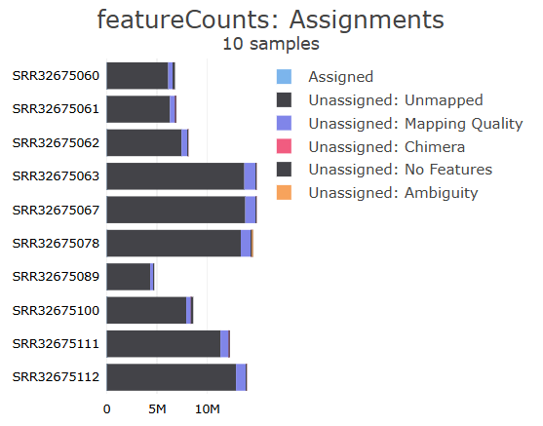
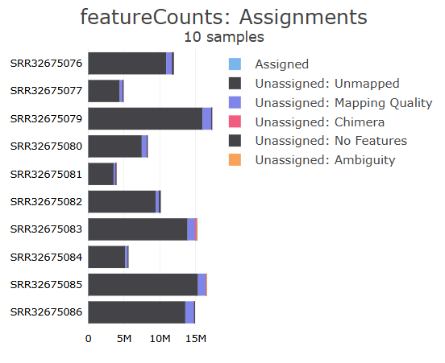
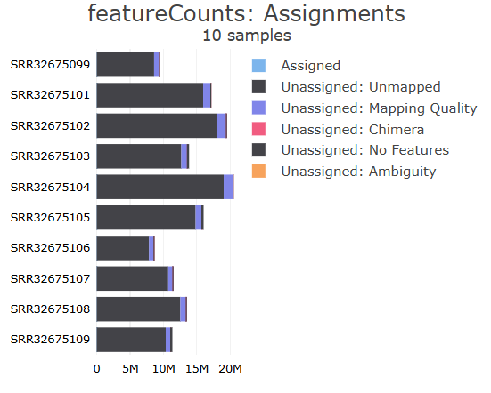
CANCER PATIENT AFTER
FEATURE COUNT
CONTROL PATIENT AFTER
FEATURE COUNT
CHRONIC PATIENT AFTER
FEATURE COUNT

Slide 11
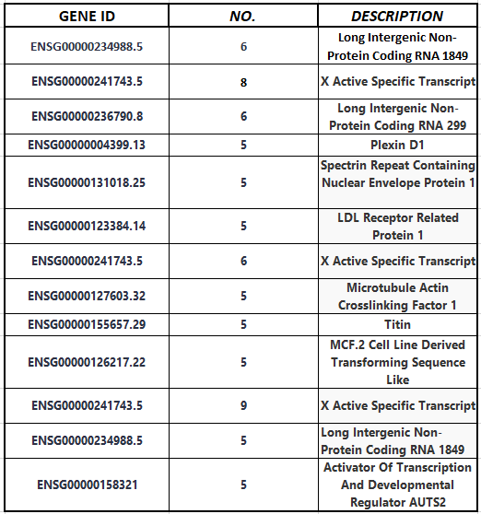
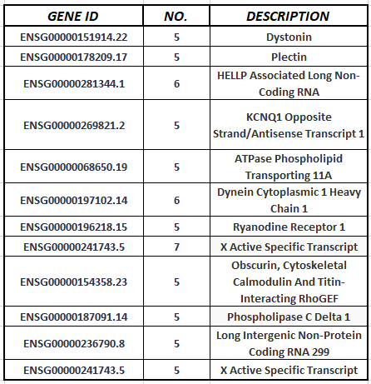
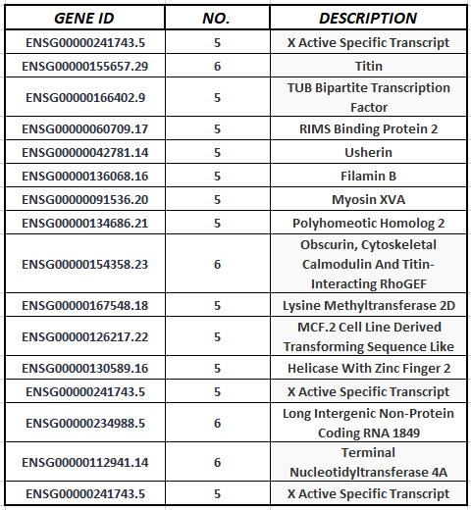
BIOMARKERS’

Slide 12
DISCUSSION
Effectiveness of bioinformatics in salivary biomarker discovery.
Advantages and limitations of using saliva over other Biofluids.
Challenges in data processing and standardization in Galaxy.

Slide 13
FUTURE SCOPE
Expanding biomarker discovery to other diseases (cancer, neurological disorders, etc.).
Validation of identified biomarkers in large-scale clinical studies.
Making of drug for the diseases

Slide 14
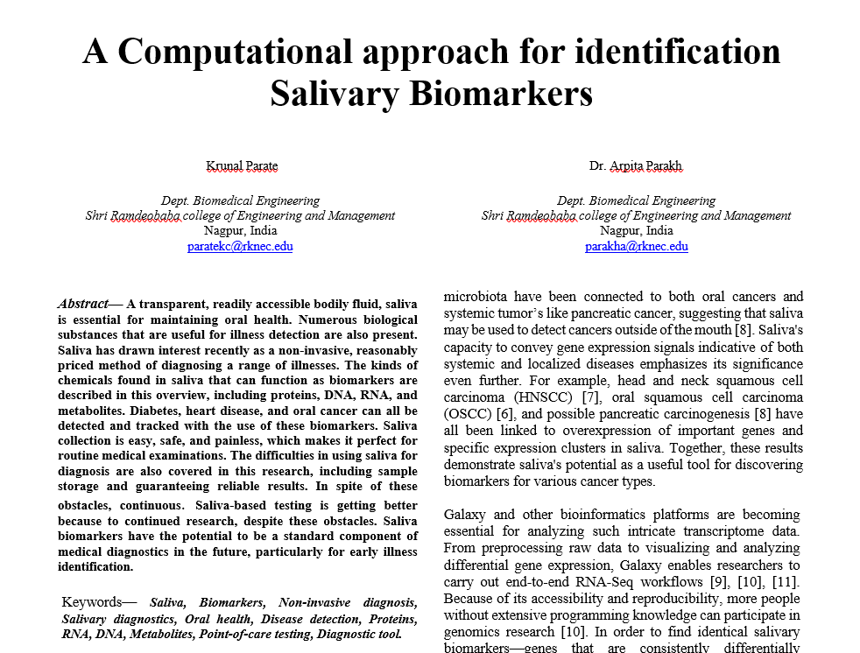
PUBLICATION
2025, 4th International Conference on Smart Generation Communication, Computing and Networking (SMARTGEN), Bali, Indonesia Co-Sponsor- Udayana University, Bali, Indonesia HYBRID CONFERENCE
Paper Id : 1687
Submission Title - A Computational approach for identification Salivary Biomarkers

Slide 15
THANK YOU

